Slide 1

DEMO
SAVE
ME

Slide 2
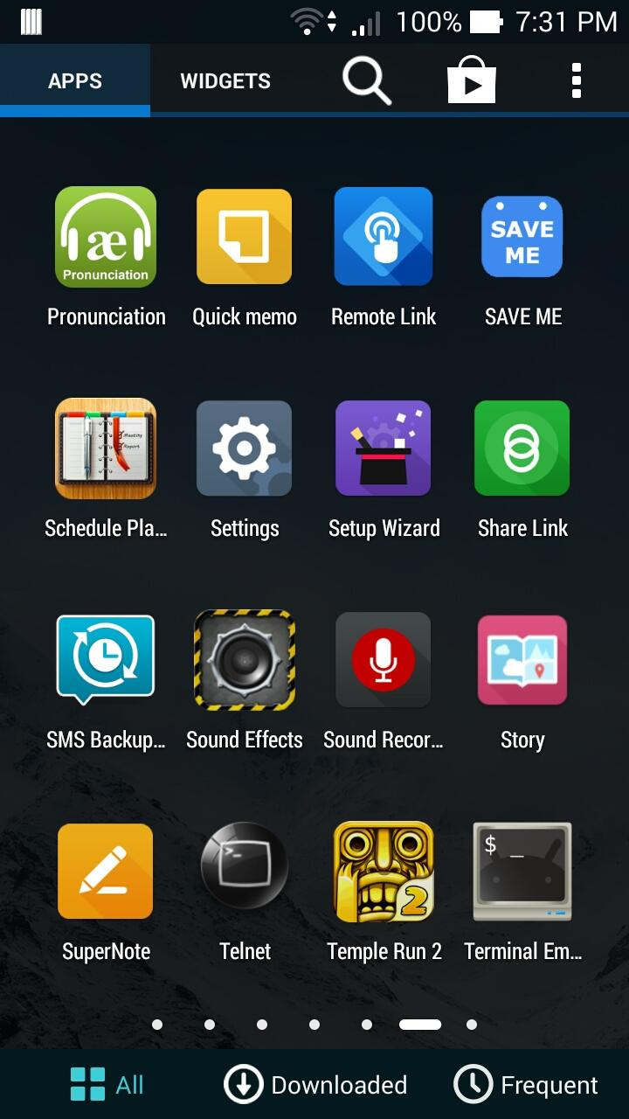
The user has just installed SAVE ME application in order to organise his studies.
He requires a Google account and a Calendar App (like Google Calendar) to make it work on his Google Calendar.
If he already has that, he can just tap on the icon and the app will start.

Slide 3
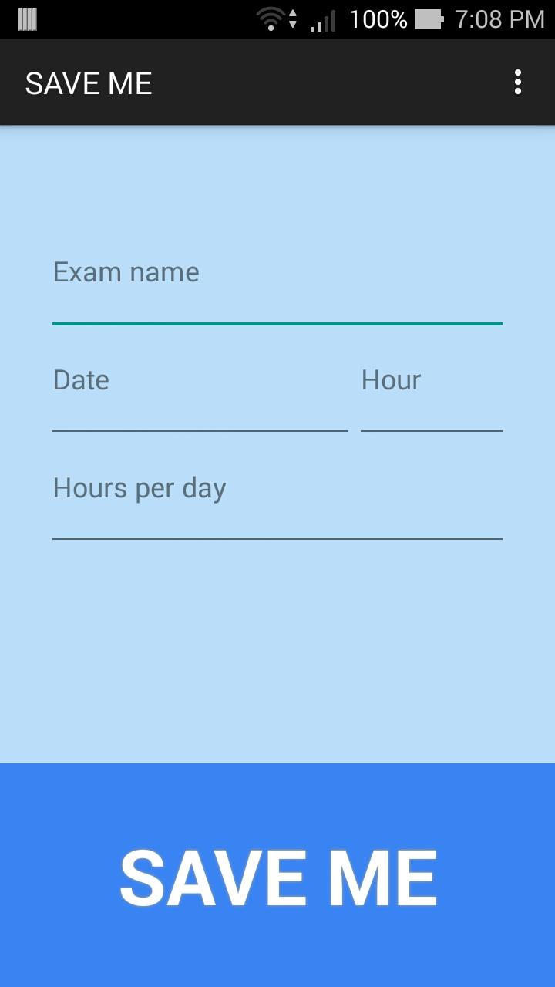
This is the main screen.
It’s pretty simple actually, so the user can easily understand how it works just by looking at it.
This way, the user can immediately begin to fill all the fields.

Slide 4
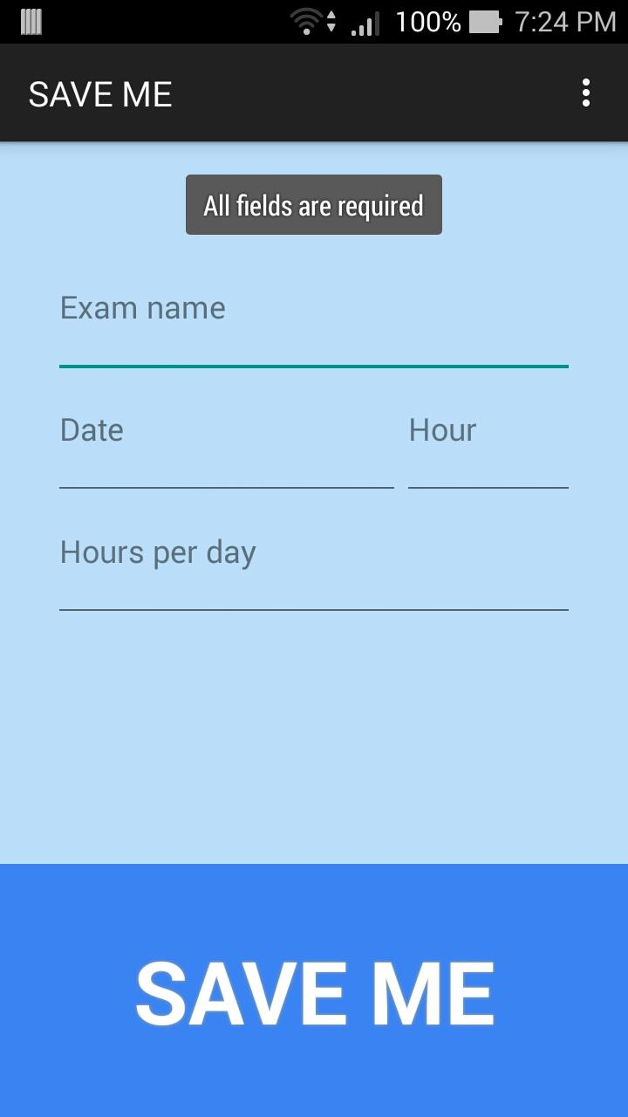
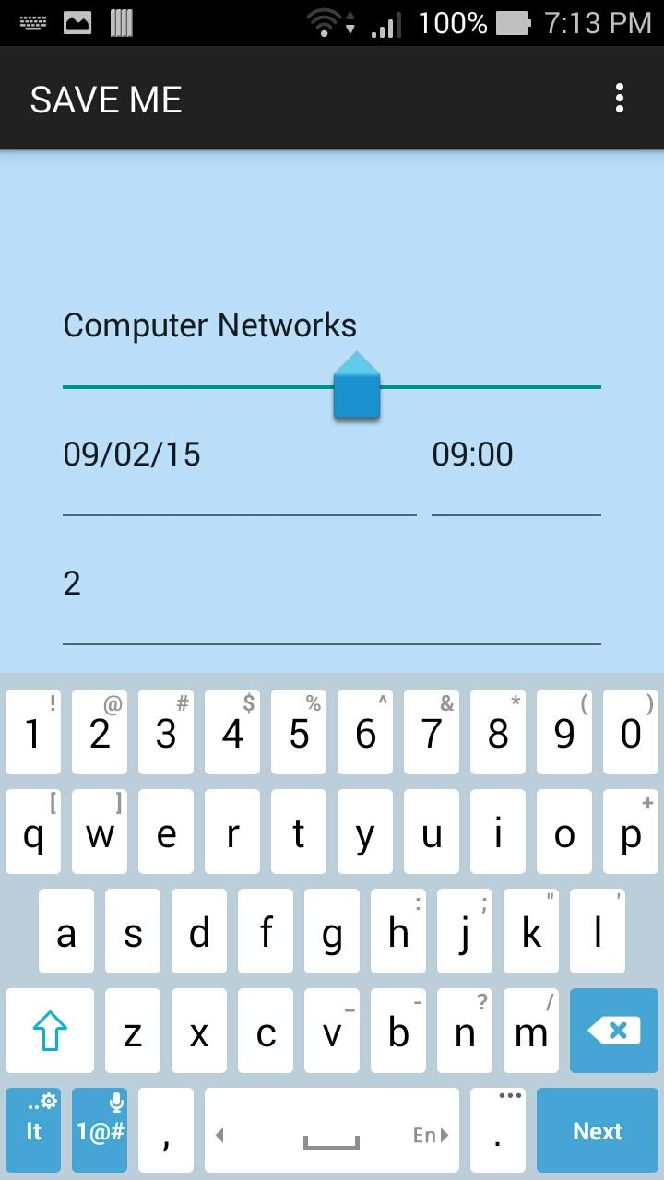
Of course, if the user doesn’t fill every field, the application will warn him with a pop-up message.
All of the fields must be filled like in the screen on the right.

Slide 5
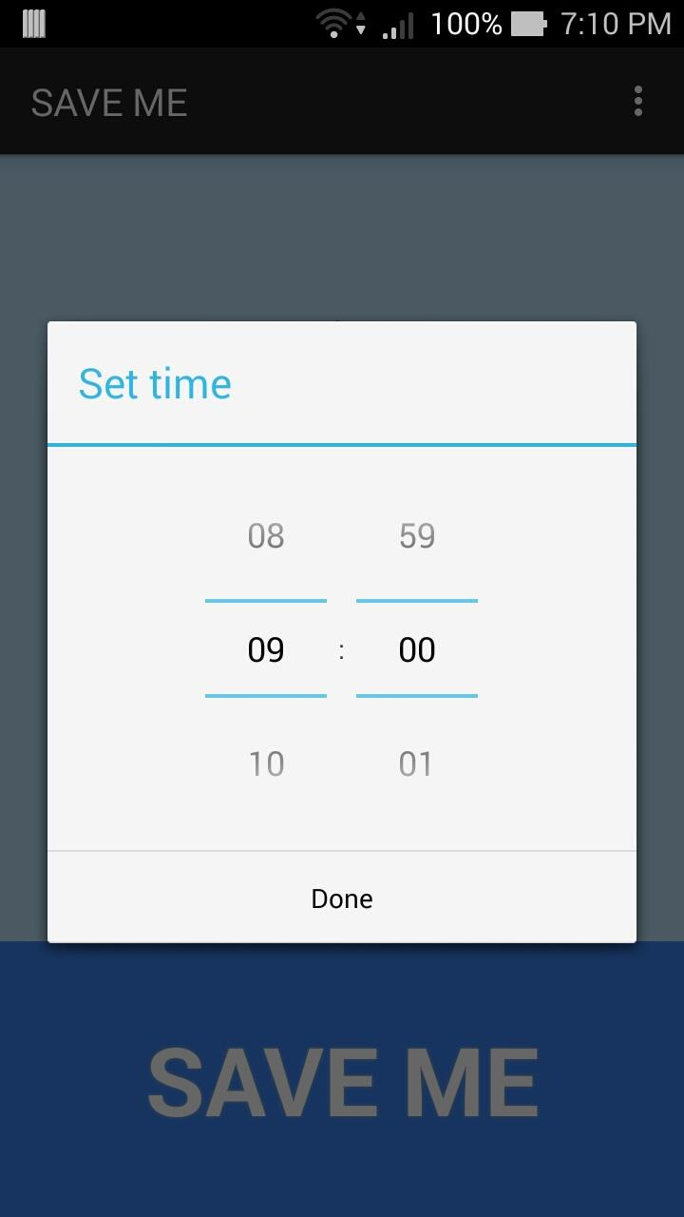
Let’s say he starts by setting the time of the exam.
(He could have started with the exam name, but the user can freely do whatever he wants!)
The exam starts at 9:00.
So the user obviously sets the time at 9:00.
He continues by setting the date.

Slide 6
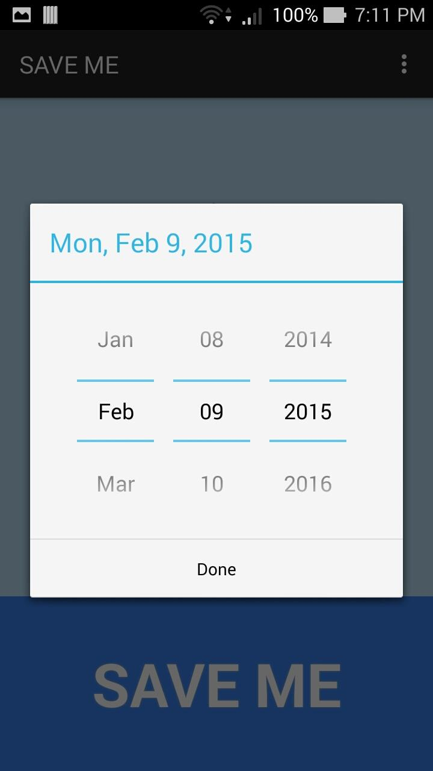
The exam is on the 9th of February 2015.
Once he has set it, it’s time to give the exam a name and select how many hours per day he wants to study it.

Slide 7
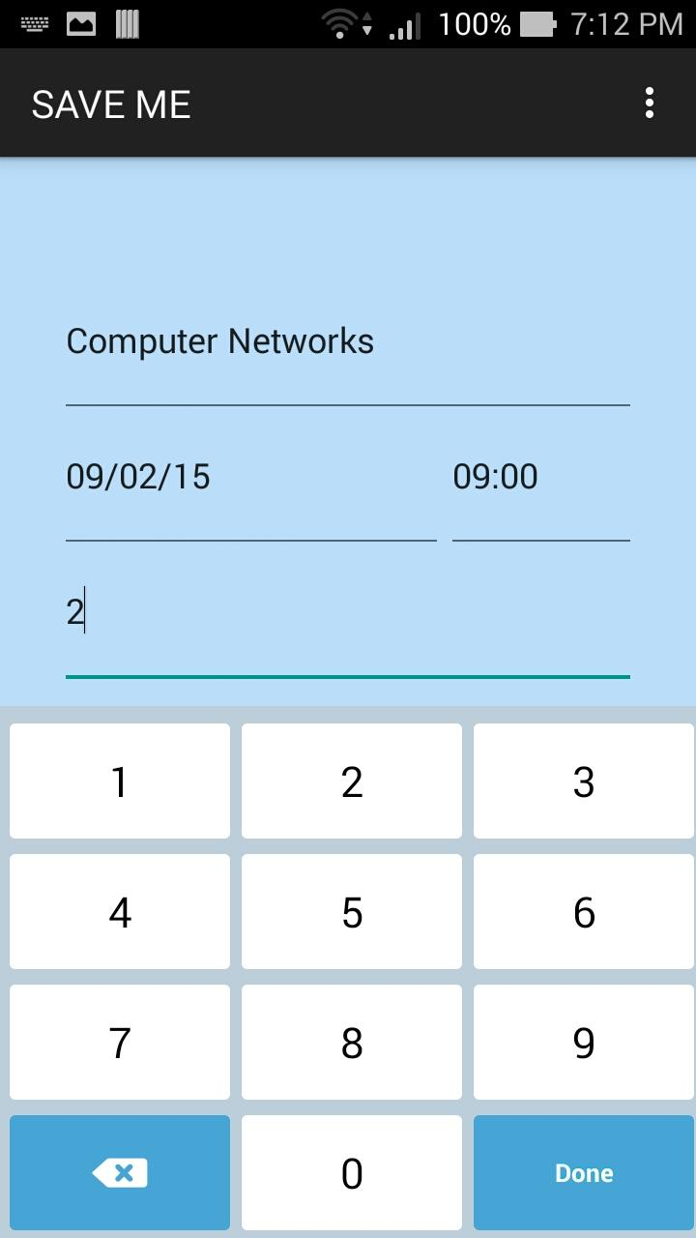
The exam is Computer Networks and he wants to study 2 hours per day.
Perfect, now he just has to click on the SAVE ME button to add the exam!

Slide 8
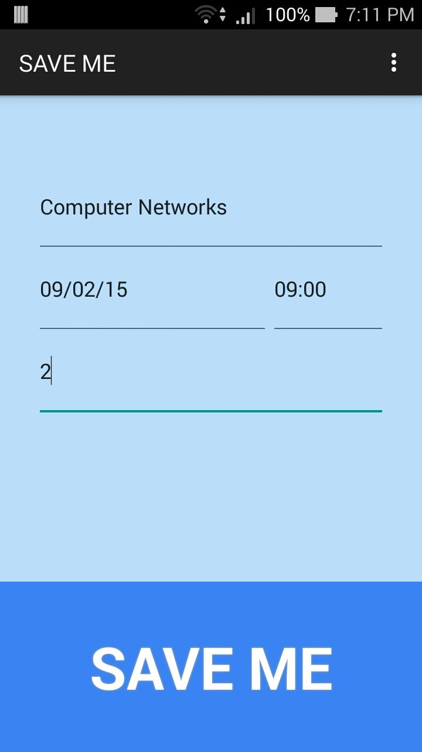

When he taps on it...

Slide 9
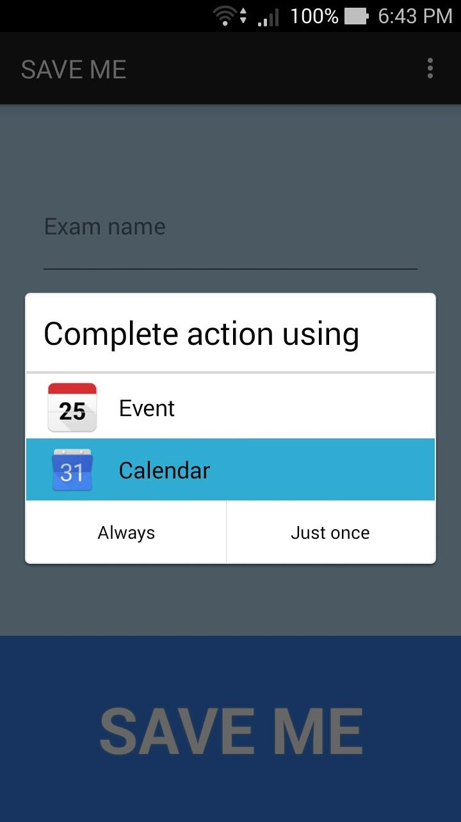
...this happens!
The application will show the user the event that has just been added.
The user can decide which Calendar application he wants to use to view it. It’s not necessary for him to use Google Calendar.

Slide 10
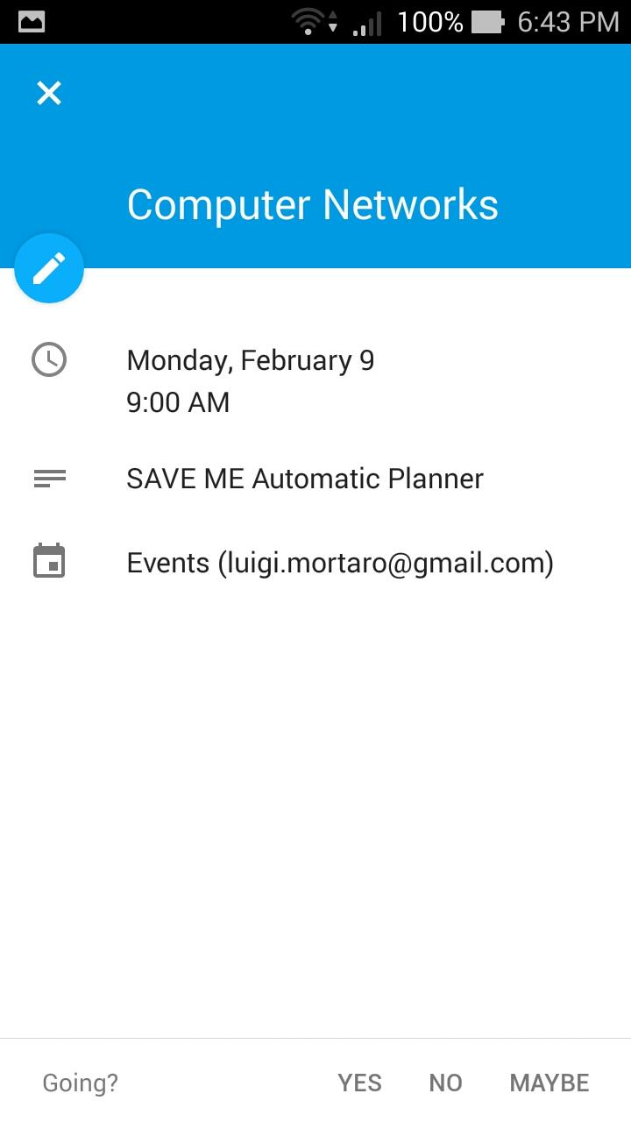
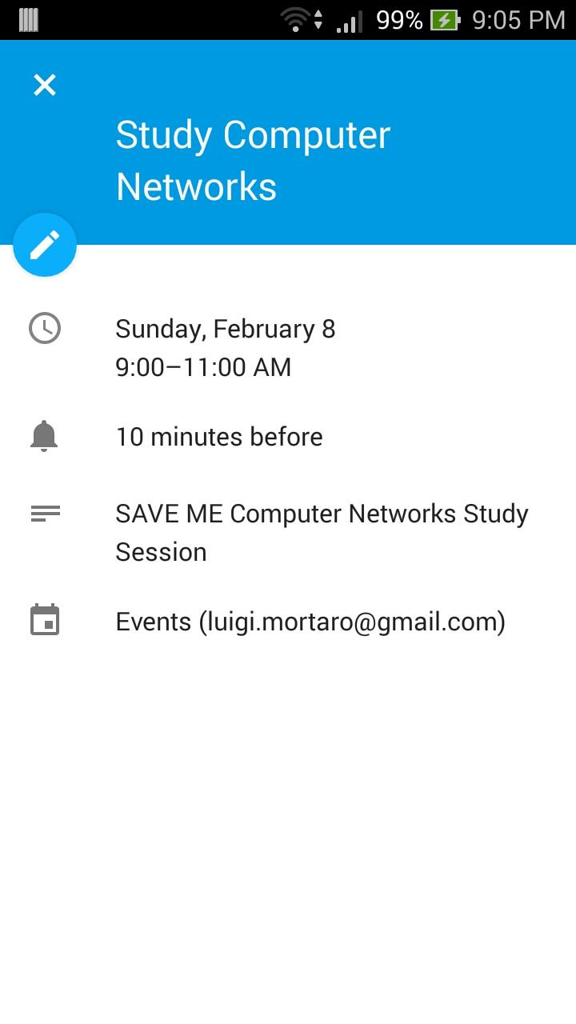
This is the exam event
These are the study sessions events
The events have been added! Let’s take a look of what happened on Google Calendar.

Slide 11
